Slide 1
Sentiment Analysis on Ratings & Reviews
Python Project
Meera P
Saravana A

Slide 2
What is Sentiment Analysis?
Sentiment Analysis is a common text classification tool that analyses an incoming message and tells whether the underlying sentiment is positive, negative our neutral.

Slide 3
Sentiment Analysis
Sentiment Analysis for Brand Monitoring
Sentiment Analysis for Customer Service
Sentiment Analysis for Market Research and Analysis

Slide 4
Scoping & Business Case
The adoption of smartphones and online social networks has experienced a dramatic growth. Online social systems such as Facebook and YouTube have more than 1 billion active users….
Sentiment analysis has become an popular tool employed in various analytic domains, especially in Web and social media, its focused on monitoring the reputation or opinion of a company or a brand with the analysis of reviews of consumer products or services
With the ratings provided by the customers, we are measuring the brand performance

Slide 5
Business Benefits & Target End-User
Develop product quality
Adjust marketing strategy
Improve customer service

Slide 6
Challenges of Sentiment Analysis
Definition problem
Multiple layers of Meaning
Recognize context, tone, and indications of sentiment

Slide 7
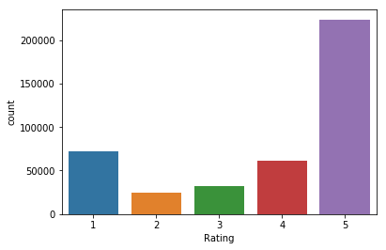
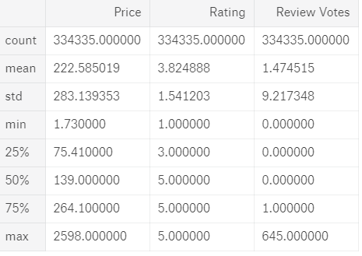
Describing the Data
“There are more no of counts in reviews for rating as 5”

Slide 8
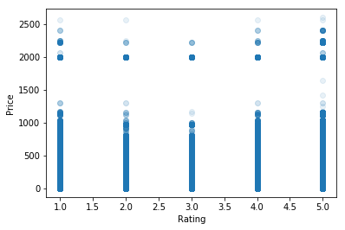
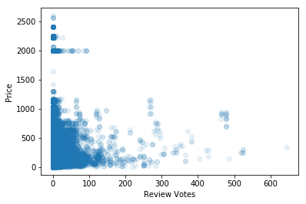
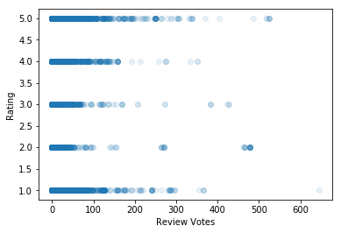
Checking for Patterns
It is observed that No Corelation between Price and Rating
Strong concentration between review votes and price
Strong concentration between review votes and Rating

Slide 9
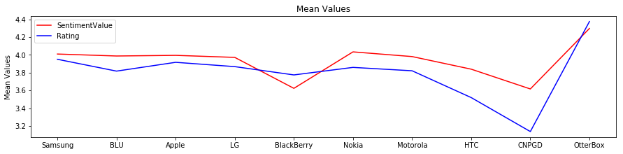
Detect Anomalies
“Difference in Mean Values in Rating & Sentimental values”

Slide 10
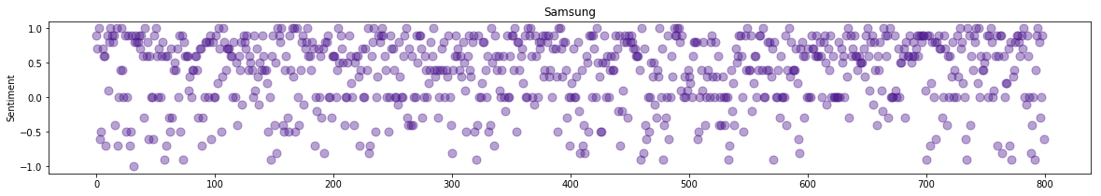
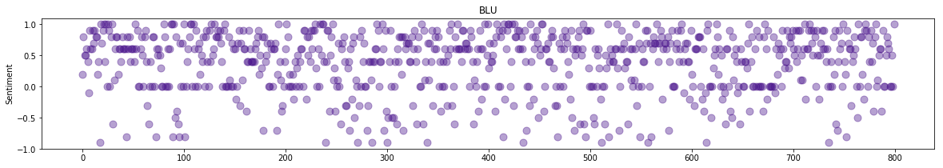
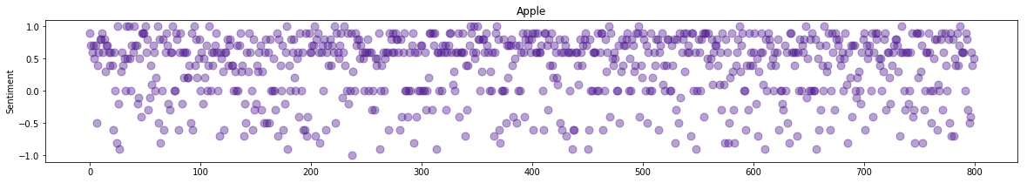
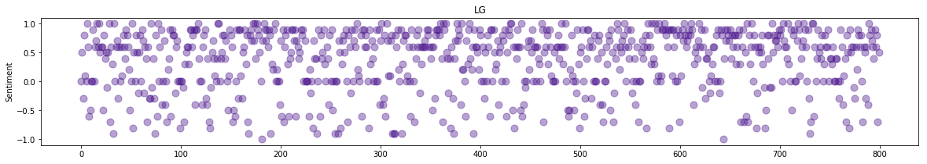
Sentiment values for top brands

Slide 11
Insights
Word of Mouth plays a very big role in Customer’s Buying decision & Major companies have realised that these Customers' voices affect shaping voice of other customers. With the help of NLP and Sentiment analysis we can keep track of these voices and manage our Brand to a large extent.

